Slide 1

Title
Pay Attention: use capital letters only for proper names and taxonomic groups. Ex:"Anatomia comparada das espécies de Astyanax Baird & Girard, 1854 (Characiformes: Characidae) da bacia do Alto Paraná, com enfoque em caracteres do esqueleto"
Authors Name | Institution
Financial Resources
Institution Logo

Slide 2
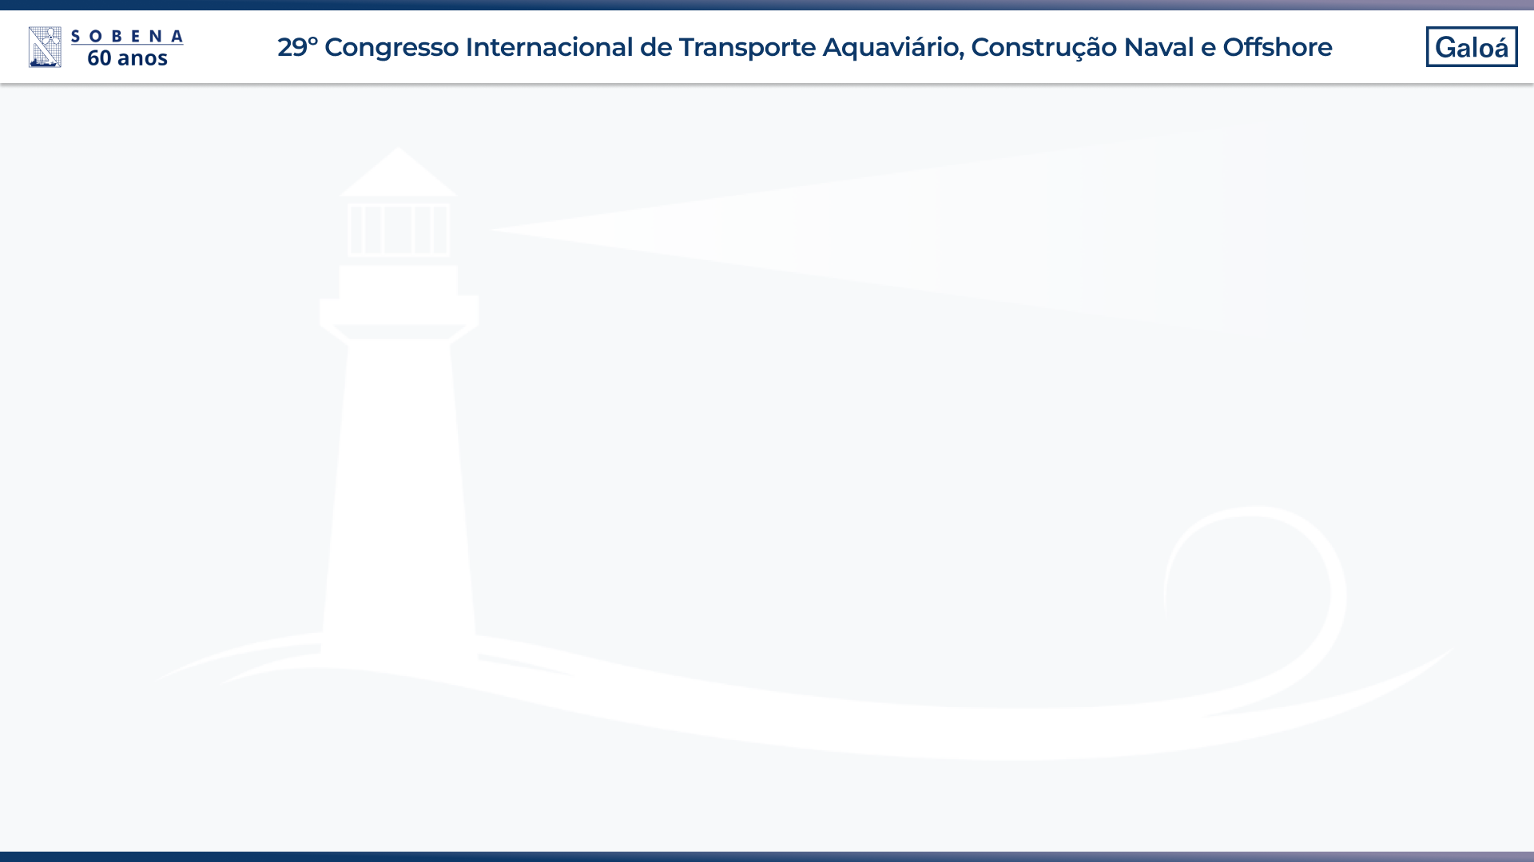
General Guideline
This is an optional template, please check the following concerns:
Slides language: portuguese or english
Language for presentation: portuguese or english
Preferably use sans serif fonts such as Arial and Tahoma. Avoid using fonts smaller than 28 points. The smallest acceptable size is 24. Always use the largest font size possible.

Slide 4
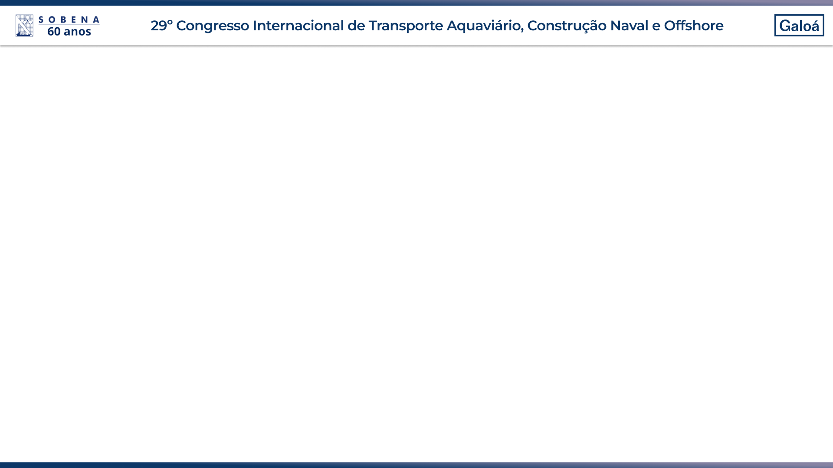
Conclusion
Acknowledgments

